Slide 1
Tables – Simple
PrintNet T

Slide 2
Context Schema
Workflow
Data Input
&
Manipulation
Document
Design
(Layout)
Impositioning
Approval (Proof)
Spool Production
Notes:
Tables are a common object in Layout.

Slide 3


Tables – Introduction
Tables are one of the best ways of organizing and presenting data.
Simple fixed table: it will be the same size in every record in the job
Notes:
Tables offer an organized possibility of presenting data which is easy to read and easy to understand. In PrintNet T, tables can be formatted and designed in innumerable ways, both simple and complex.
Fixed tables feature a fixed number of rows and a header and footer, if necessary. Fixed tables can contain variable information, but they will not be variable in size – the rows will not be repeated by any data.
Repeating tables are more complex. They will be different from record to record, as their rows will be repeated by a particular data variable, which will have different values for each record (customer).

Slide 4
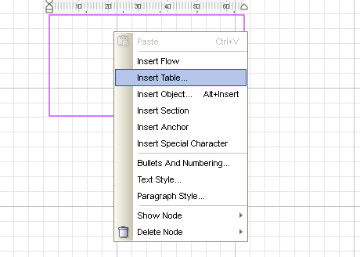
Tables – Setup
To create a table, you need a flow area.
Right-click in the flow area, and choose “Insert Table”.

Slide 5
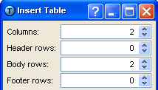
Tables – Setup
The following dialog will pop up; you will need to select the number of columns and rows for your table.
Choose your number of columns
Simple fixed tables require only a specific number of body rows; leave header and footer rows at 0
Notes:
Of course, the number of columns and rows needed will vary depending on the data and purpose of the table. Header and Footer rows really only matter if you are making a complex table repeated by some data array. For now, we will work on creating a simple table, so just state the number of rows you will need in the “Body rows” part, and leave the Header and Footer rows at 0.

Slide 6
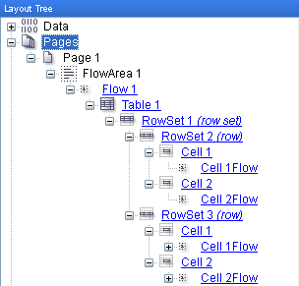
Tables – Layout Tree
Notice the basic structure of a simple table in the Layout tree.
Rename your nodes!
Notes:
It is a good time to re-emphasize the importance of renaming nodes as you create new objects in a layout. Especially with tables, where flow area, flow, rowsets, rows, and cells all play important roles, renaming nodes will make it easier not only for other people using the job later, but for you as you create the Layout design itself.

Slide 7
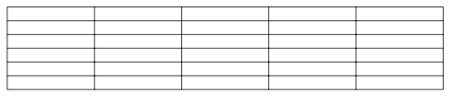
Tables – Features
Three main features of a table:
  Rowsets – a group of one or more rows
  Rows – a single row is all of the cells with the same “y” axis coordinates in a table.
  Cells – one single box in a table.
Single cell
Single row
Rowset
Notes:
Rowsets: Rowset is a misleading word; it can be ANY group of rows (including one). Whenever you create a table, you will automatically have one rowset (the table itself). Other rowsets can be created later when working with variable row selection, but it’s not necessary to explain here.

Slide 8
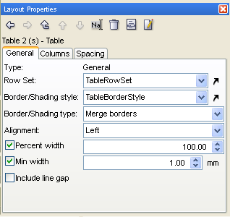
Tables – Layout Properties
General Tab:
This rowset will be the content of the table.
Border settings for the table.
Settings for the horizontal position of the table.
Can leave a small gap between text and table border.

Slide 9
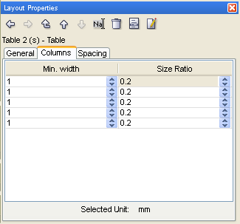
Tables – Layout Properties
Columns tab:
Set exact widths of each column.
Notes:
column widths can also be set quickly, but less accurately, in the Layout area by holding down <Ctrl>, clicking, and dragging your column to the width required or desired.

Slide 10
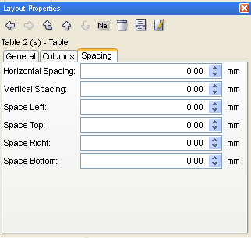
Tables – Layout Properties
Spacing tab:
Adjust the spacing between cells.

Slide 11


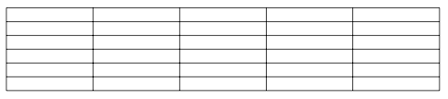
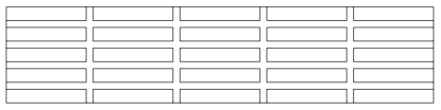

Spacing – Example

Slide 12
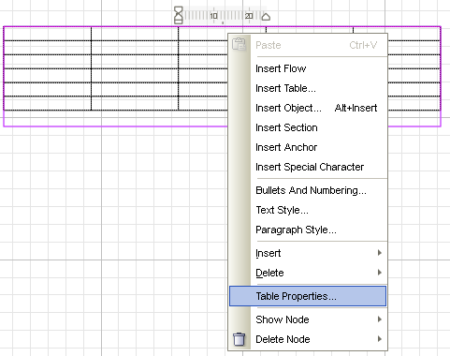
Table Properties
Aside from Layout Properties, tables have their own properties menu.
Simply right-click on the table and choose “Table Properties”.
Notes:
You must have flow area tool selected when right-clicking!

Slide 13
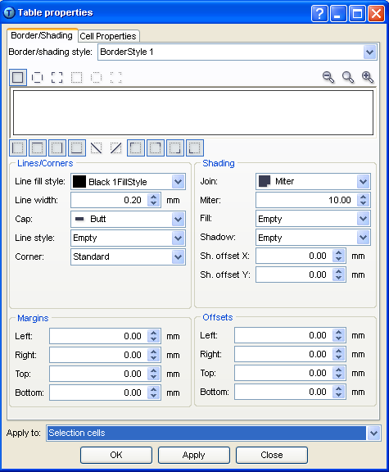
Table Properties
Border/Shading tab:
Choose Border/Shading Style
Choose border outline type
Preview window
Choose border outline type
Where you will apply these table settings
Notes:
Choose a previously created borderstyle.
Apply to:
All table
Table
Table cells
Selection cells
Boundary
Boundary and clear

Slide 14
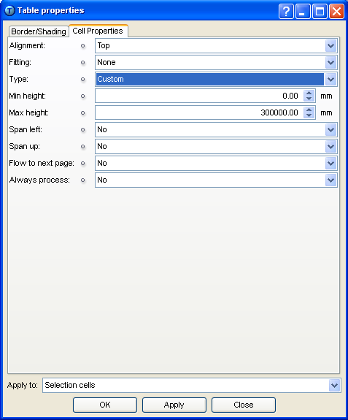
Table Properties
Cell Properties tab:
Adjust the maximum and minimum height of your table cells
Notes:
You can also set cell height quickly, but less accurately, in the Layout area by holding down <Ctrl>, clicking, and dragging your row to the height required or desired.
Three types of cell height:
Custom: The cell height is adjusted according to the height of the content within a size limit determined by the user. When selected, the Min height and Max height edit-boxes are displayed where the size limit can be specified.
Fixed Height: Sets the height of a cell to a constant size, regardless of the data populating it. When selected, the Fixed height edit-box is displayed where you can specify the height of the cell(s).
Calculate fixed height: The cell height is adjusted according to the height of the content. When selected, no further settings are necessary.

Slide 15

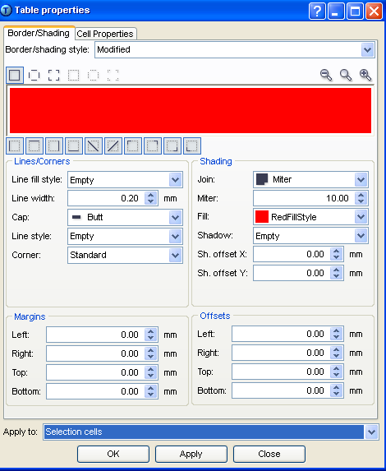
Tables – Tutorial
Create a table and format its border and shading.
  Create a table with more than two rows.
  Highlight all cells and open Table Properties.
  Select a color for your fill style.
  Apply to all cells.

Slide 16
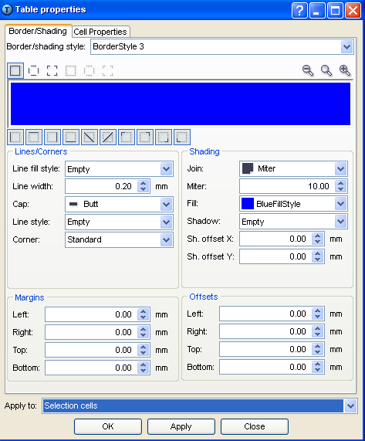
Tables – Tutorial
Create a table and format its border and shading.
  Highlight all cells in the second row.
  Open Table Properties and select a different color as a fill style.
  Apply to those selected cells.

Slide 17
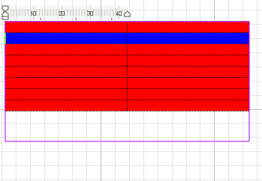
Tables – Tutorial
Create a table and format its border and shading.
  Your table should look something like this (colors can vary).

Slide 18
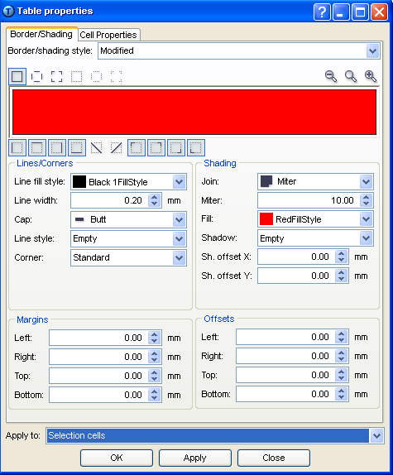

Tables – Tutorial
Create a table and format its border and shading.
  Highlight the whole table again and open Table Properties.
  Select black color for your line fill style.
  Apply to all cells.
Before you apply your line fill, notice the preview window has only one color as a fill style, even though you have already applied two colors to it.

Slide 19
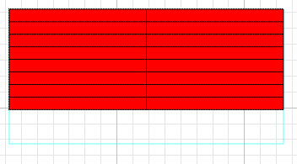
Tables – Tutorial
Resolution.
  Your second row cells have lost the blue fill style you applied earlier. You have overwritten them.
When creating tables, format your uniform features BEFORE you format any differing features.
Notes:
Because border styles and fill styles are formatted in the same dialog, it can happen if you’re not careful that you overwrite previously formatted cells. In this tutorial, we overwrote the fill style format, but it is equally possible to overwrite differently formatted border styles as well. The best way to avoid this is to format the parts of your table that will be uniform first, and then format different cells in smaller groups after. For example, in this tutorial, we wanted to have the whole table border formatted the same; it would be wiser for us to format the border first, then apply the red fill style to the entire table, and then format our second row.
Overall, pay attention to both border styles and fill styles in the Table Properties dialog before applying any changes. If you accidentally overwrite your formatting, you can revert back in the Edit menu: Edit | Undo.

Slide 20
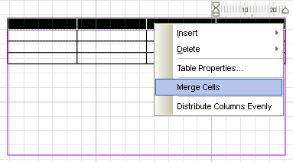
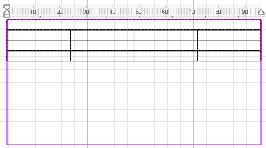
Table – Merging Cells
Cell merging can enhance the look of a table.
Highlight desired cells; right-click and then select Merge Cells.
Notes:
The cell merging is used often in headers and footers to get better looking design of the table.
Highlight desired cells with mouse. Click on the right mouse button and then on Merge Cells.

Slide 21
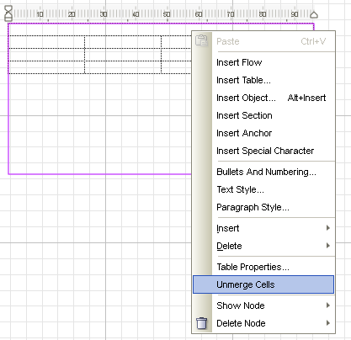
Tables – Unmerging Cells
Unmerging previously merged cells is also possible
Notes:
To unmerge cells, the process is reversed. Right-click on previously merged cell(s) and select Unmerge cells.
It is not possible to unmerge (i.e., to split or divide) one single cell which has not already been merged before.

Slide 22
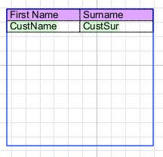




Tables
Tables can contain either fixed or variable text.
Layout view
Proof view <F6>
Record 1
Record 2
Record 3
Record 4

Slide 23

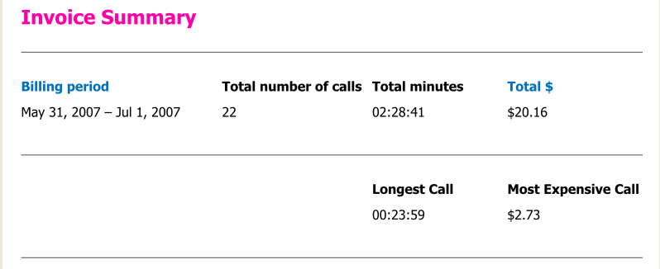
Tables – Exercise
Create a simple table with fixed and variable text.
  Open SimpleTableExercise.wfd
  In the empty space in Layout, create a simple table that looks like the example below; including formatting (use Line gap).
  Insert the appropriate variables into the blank cells.
  Proof your job <F6>
Notes:
Check SimpleTableExercise_done.wfd for resolution.
Colors are already included in the job
Only three rows are necessary

Slide 24

Simple Tables – Summary
In this presentation we have learned:
  How to:
    Insert tables into a flow area
    Create a fixed table
    Access the Table Properties menu
    Merge and unmerge the cells

Slide 25

Simple Tables – Discussion
How do you insert a table into Layout?
What are the three basic structural elements of a simple table?
Why is it a good idea to rename your table nodes in the Layout tree as you go?
How do you change the width of columns and height of rows?
Is it possible to apply a Border/Shading Style to just a single table cell?
Notes:
How do you insert a table into Layout?
Double-click on a flow area, right-click, and select “Insert Table”.
What are the three basic parts of a simple table?
Rowsets, rows, and cells.
Why is it a good idea to rename your table nodes in the Layout tree as you go?
Because tables contain a lot of nodes as soon as they are created, and it can be difficult to navigate in the Layout tree if all your nodes are named like “Rowset1”, “Row1”, “Row2”, “Cell1”, Cell1Flow”, etc.
How do you change the width of columns and height of rows?
You can make rough changes to both by holding down <Ctrl> + clicking and dragging. You can make precise changes to column widths in a table’s Layout Properties, and you can make precise changes to row heights in a table’s Table Properties.
Is it possible to apply a Border/Shading Style to just a single table cell?
Absolutely. Make sure you have selected the cell you want to format, right-click on it, and select “Table Properties”. In the Table Properties menu, format your Border/Shading Style, and at the bottom of the dialog select “Apply to: Selection cells” in the combo-box. It is also possible to apply changes to individual cells by clicking on the desired cell in the Layout tree and modifying its Layout Properties.

Slide 26

Thank You.
Do You Have Any Questions?

